Slide 1
Library
Starter Kit
Compiled by
Helene van der Sandt

Slide 2
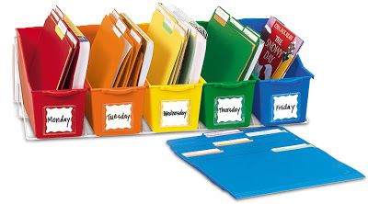
Contents of Starter kit
Library membership: Registering, borrowing, etc
Online presence: Library Web Page, Social media
Facilities: wifi, photocopiers, computers
Information resources: Classic Catalogue, FindPlus, InfoWise

Slide 3
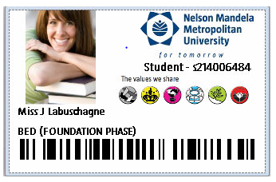
Library membership
Renewing books
Borrowing books
Overdue Charges
Short Loans

Slide 4
What must I do to become a library member?
Please do not let other students use your student card.
You are responsible for all items issued on your card.
Please register as a LIBRARY USER
at the Circulation Desk.
Bring your student card to register
for first time and every year there-after.
Provide 2 different contact numbers.
No CARD
= No Library entrance
= No books on loan
= No computers
= No Services

Slide 5
borrowing from library
Patron type | No. of items | Loan period
First – Third year students | Total items = 10 | 14 days
Renewing of items
Patrons may renew library material
by phone,
online via the Classic Catalogue or
in person at the Circulation Desk.
Library material can be renewed once unless another patron has booked the item.

Slide 6
OVERDUE / LOST CHARGES
This overdue charge will change to a billing fee of R100 per book once the book is more than 30 days overdue.

Slide 7
SHORT LOANS / COURSE RESERVES
Books, articles or class notes placed by the lecturer
You must have:
Student card
Shelf no. of the item, looked up in Classic Catalogue
Items can be used for 1 hour at a time
One renewal in person per item, provided another student has not booked the item
Short Loans are behind Circulation Desk
on Ground Floor
Notes:
Refer to p. 8

Slide 8
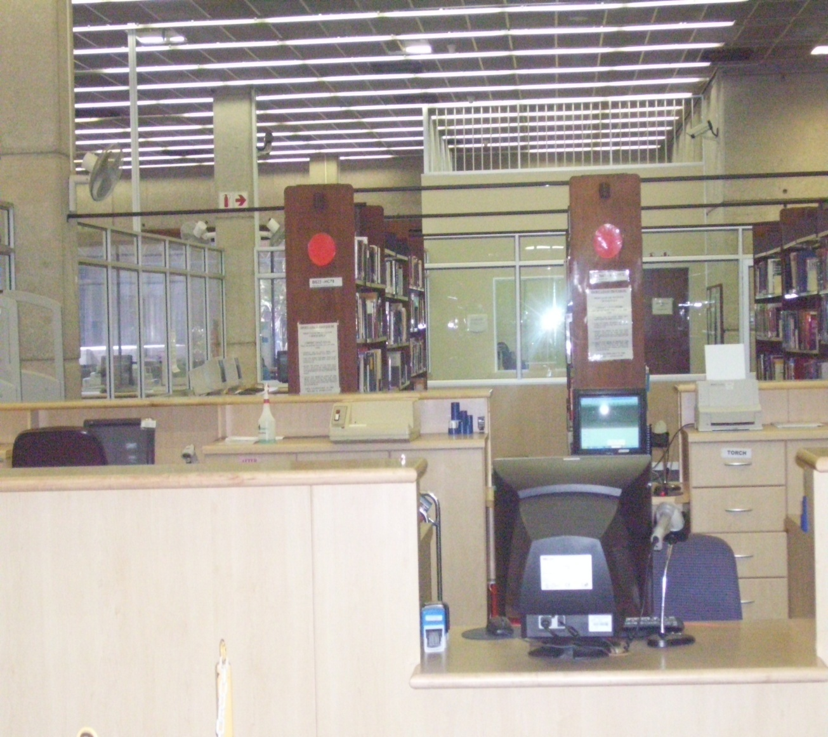
STUDY COLLECTION
Copies of prescribed books
May be borrowed for 3 days
No renewals or reservations for this collection
Study Collection is also behind Circulation Desk on Ground Floor
Notes:
p. 8-9

Slide 9
Library facilities

Slide 10
Facilities
Copiers/printers on all floors. Use the same system as in labs.
S
Special needs
4 dedicated (wheelchair friendly) workstations
Magnifier
Zoom Text software
Special keyboards with large icons, a dedicated scanner and printer
Computer Work Stations issued 1 hour at a time.

Slide 11
Online presence

Slide 12
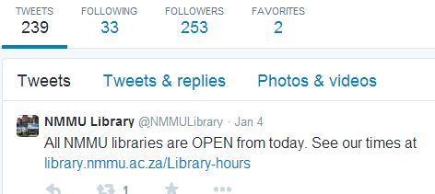
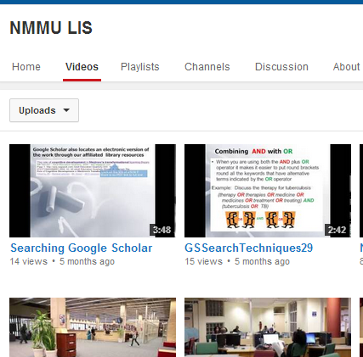
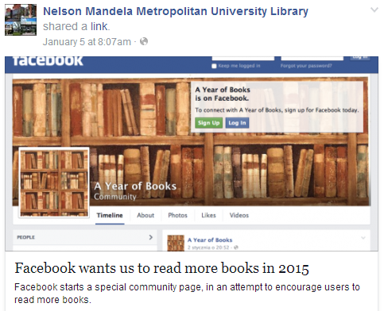
Social media
Twitter
http://twitter.com/NMMU
NMMU Library onTube
http://www.youtube.com/user/NMMULibraryonTube
Facebook:
http://www.facebook.com/NMMULIS

Slide 13
Library website:
http://library.nmmu.ac.za
Quick Links
Menu
Please check here for available free Library training sessions.

Slide 14
On the Librar site you wil find:
Links to
Information Resources:
Classic Catalogue
FindPlus
Online Databases
InfoWise
Google Scholar
Old Exam Papers
Mobile Library Catalogue, etc.
Information about:
Library Hours
Library training sessions
Information Commons
E-forms
Photocopying and Printing
Inter-Branch Loans, etc.

Slide 15
Information resources
Classic Catalogue
FindPlus
InfoWise

Slide 16
Information resources: starter kit
Find books, articles and class notes placed in the Reserve/Short Loan Collection.
InfoWise provides information on how to do assignments.
You can search multiple Library resources (books, journal articles) all at once with a “Google-like” search.

Slide 17
looking up short loans / course reserves in Classic catalogue

Slide 18
Go to Classic Catalogue

Slide 19
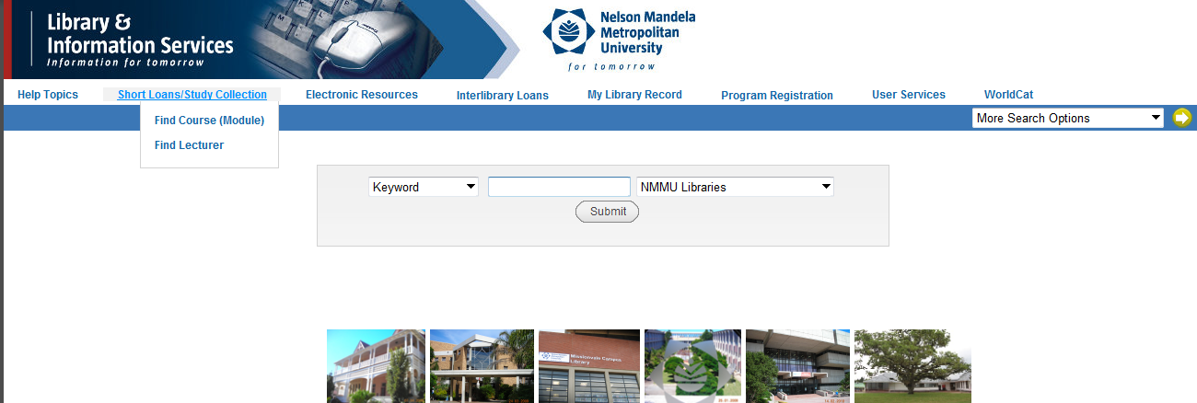
Access Short Loans/Course Reserves
You can either search by course code or by lecturer’s name

Slide 20
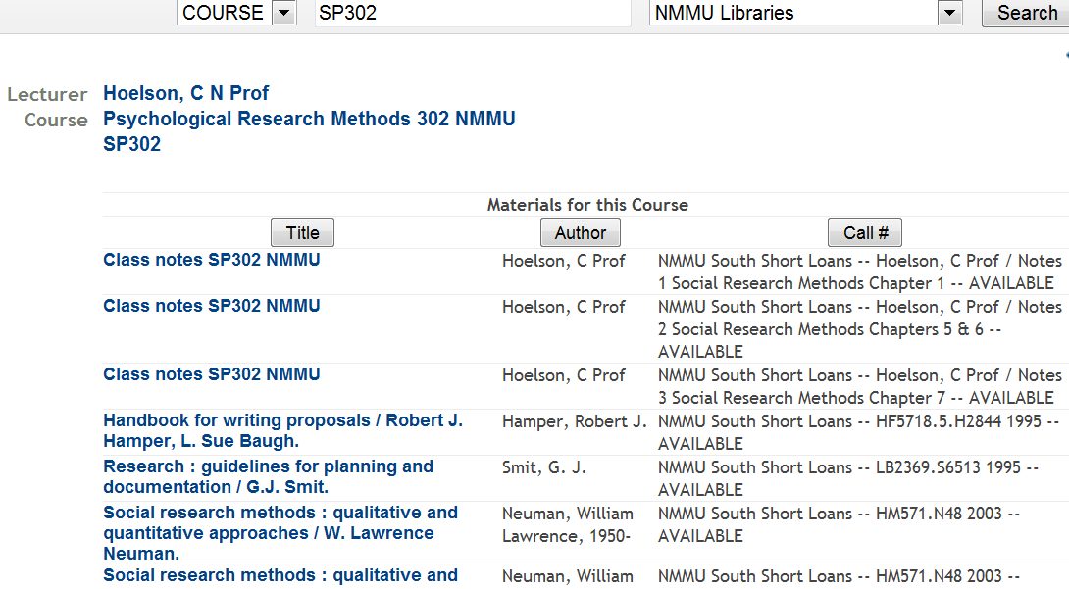
Example of items on Short Loan
You need the following information:
Lecturer’s name
Books: shelf no.
Articles, class notes: box no.

Slide 21
Find books articles etc in findplus

Slide 22
Do a search in FindPlus

Slide 23
search findplus
Enter a word or phrase in the Search text box, and then press
Search Terms
You can enter an author's name, a title, or keywords describing a subject.
FindPlus returns a list of all the library resources that match your search terms.

Slide 24
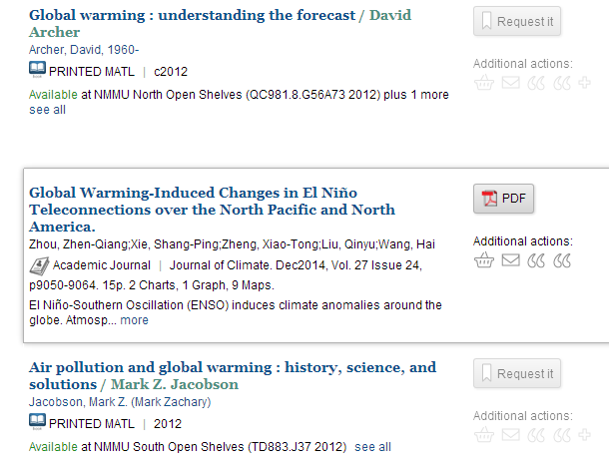
Findplus: Search results
Printed Material (see next slide).
Online journal article.
Click on PDF to view.

Slide 25
Search result list: printed material
4.
1.
2.
3.
Text and/or icon to indicate the type of material.
When multiple copies are available, the list does not appear until you click title or
This icon displays if one or more of the copies is in Short Loan or Study Collection.
You can only request material from other Campuses or “out on loan” copies.

Slide 26
findplus : multiple copies of print material
1.
2.
4.
3.
Untick this option to view all copies.
Check the Campus library (e.g. NMMU South, etc.) as well as the collection (e.g. Short Loans, Open Shelves, etc.) in which the item is.
Copies at other academic institutions in the Eastern Cape, will also display.
Write down the call number (shelf address) of the item to be able to find item on shelf.

Slide 27
Finding a book on the shelf with the call no

Slide 28
Reading call numbers
r

Slide 29
Reading call numbers

Slide 30
One last word
Please register at the Library as soon as you receive a student card
Please attend free Lunch hour Library training sessions
Remember the Big 3 information resources on Library Page (Classic Catalogue, FindPlus and InfoWise)
Remember that Short Loan or Course Reserves can be looked up in the Classic Catalogue
Library booklets are available @ Library

